Slide 1
Asian Restaurant in UK
Sophia Wu
29/11/2020

Slide 2
Contents
Background
Business Problem and Problem Statements
Data
Discussion and Result
Conculsion and Limitation

Slide 3
Background
Many Hong Kong people are planned to immigrate to other countries
Due to the unstable political environment after Anti-Extradition Law Amendment Bill Movement
UK would be one of the popular countries for immigration
Hong Kong was the colonies of UK before 1997
Relaxed immigration policy to BNO holders
More Hong Kong People immigrate to the UK, the demand for Asian / Chinese restaurants would increase.

Slide 4
Business Problem & Problem Statement
To find out the location which is suitable for opening a Hong Kong or Chinese restaurant in London
Districts with fewer asian restaurant in order to build the reputation faster.
Districts with more low ranking restaurant in order to have less competition since we are targeting with the high standard of Traditional Hong Kong Cuisine

Slide 5
Target Clients
UK local catering company
Enlarge their business with the growing customer to Asian/Chinese cuisine from Hong Kong immigrants.
Hong Kong immigrant
Invest in the UK for the chinese restaurant business which can bring Hong Kong Cusine to the UK.

Slide 6
Data & methodology

Slide 7
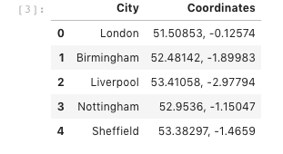
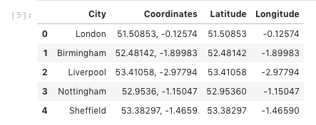
Data from Geodatos
UK cities name and their Latitude and Longitude coordinates is collected from https://www.geodatos.net/en/coordinates/united-kingdom
Data cleansing to slipt coodinates into longtitude and latitude

Slide 8
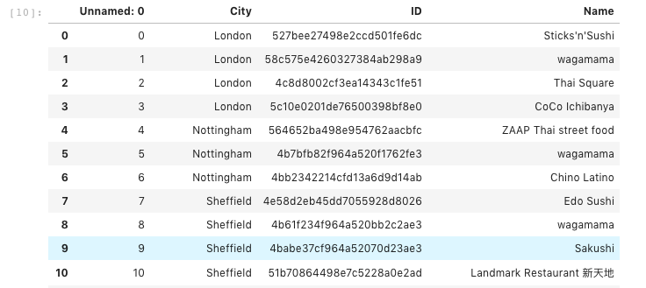
Data from FourSquare
Location, name, categories in the UK would be collected from FourSquare.
The frequency , venue type and rating would be saved in data frame.

Slide 9
Discussion and result

Slide 10

How many Asian restaurant in UK?
There are 36 Asian restaurant in UK

Slide 11
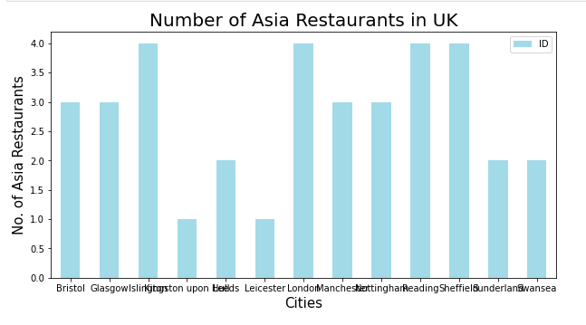
Restaurant number over cities

Slide 12
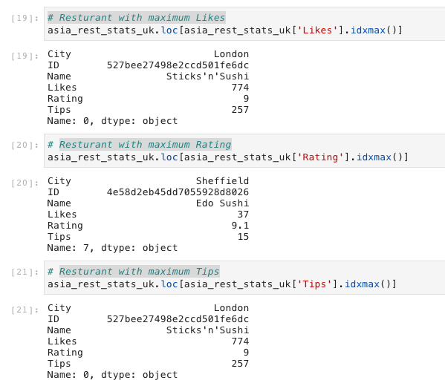
Top restaurants in Likes, rating, Tips
Resturant with maximum Likes and maximum Tips is Sticks'n'Sushi in London. Resturant with highest rating is Edo Sushi in Sheffield.

Slide 13
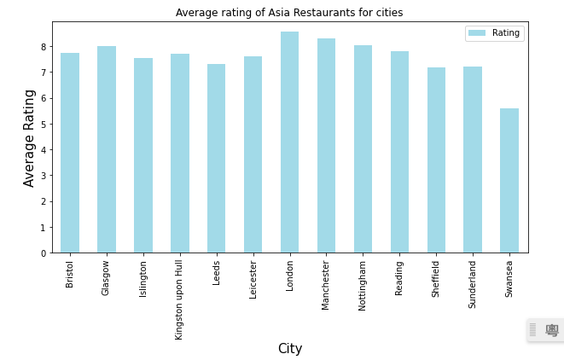
Highest RatinG over cities

Slide 14
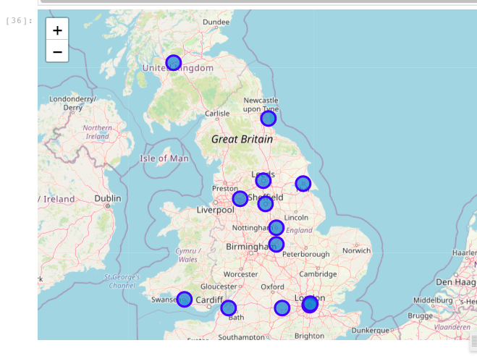
Map of average rating over Cities

Slide 15
Result
In the UK, London and Manchester have relative high rate chinese restaurants in average.
Swansea has lowest rate chinese restaurants in average.
Resturant with maximum Likes and maximum Tips is Sticks'n'Sushi in London. Resturant with highest rating is Edo Sushi in Sheffield.
Chinese restaurant only have 9 restaraunt in the UK.
niche market for chinese cuisine.
Sushi is easier to have a higher rating for the restaurant, but also in a higher competition.

Slide 16
Conclusion and limitation
Recommend the local catering company to open a Chinese restaurant in London and Manchester
since they have more experience on local restaurant.
Hong Kong immigrant would be suitable to open in Swansea
less competition to gain the reputation faster at the beginning.
Due to the limited data from Foursqaure, analysis cannot have a fully picture on the distribution of all restaurant in the UK.
Further detail research and analysis have to made and more data from external database.

